Slide 1

The Brogrammers
Rahmeen Habib
Akshita Aggarwal
- Sarthak Tandon(sarthak0120)

Slide 2
THEME: AGRICULTURE
SUB-THEME : Open Innovation

Slide 3
PROBLEM STATEMENT
An in-person visit to a nearby sub-urban farming area in Delhi brought to foreground the following problems of a humble, mundane framer:
-Laborer deficit (hard to find laborers)
-Foul agricultural malpractices of fellow-farmers that need reporting
-Crop yield uncertainty
-Price disparity on both buying(of seeds) and selling(of crops) ends
-Lack of awareness of new developments in agriculture
We offer a web-based solution that tries to tackle each of these problems in a near efficient way. We intend to revolutionize agriculture in our own little attempt.

Slide 4
SOLUTION
The beneficiaries include -
Farmers: A sellers’ portal will help the farmers choose the minimum cost seeds/fertilizers/ equipments by cost comparison. Also the buyer’s portal will not only connect the farmer with direct buyers of his goods but will also help him compare day-to-day varying prices across nearby markets to choose the most profitable one. A communication channel we intend to set up will be an added advantage that can also help farmers collaborate among themselves and hence order in bulk to optimize on cost.
Laborers: The ‘dispatch latency’, i.e., the time laborers waste looking for employment once their task at one farm is over will be minimized as our farmers will update their need for laborers in our app under the ‘Laborer’ tab and the other farmers while paying the laborers off will direct them to where they’re needed
Government: The report on malpractices (anonymously done but duly filtered) will help the government track and punish the culprits
Common masses: They will have access to better quality and better priced products
This will impact farmers to make them more aware, informed, independent. The laborers will find quick employment; people will have better quality food and the government will be geared into action.
The country’s farming front (crucial to its economy) will be strengthened and change will be made.
We plan to use Node.js , Mongo DB , JavaScript ,Socket.IO (for communication channel) and Python(for Machine Learning)

Slide 5
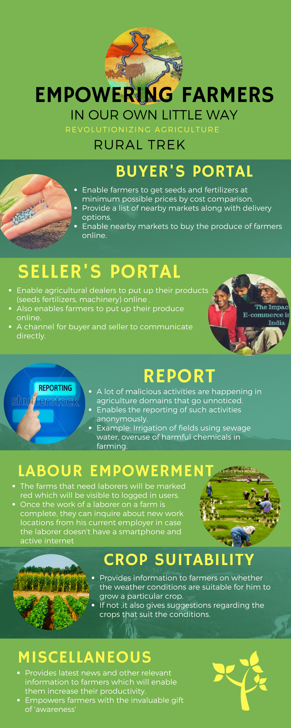
ADDITIONAL SUPPORT DOCUMENTS Diagram showing our solution :

Slide 6
THANK YOU
☺

